Slide 1



Brand Assets

Slide 2


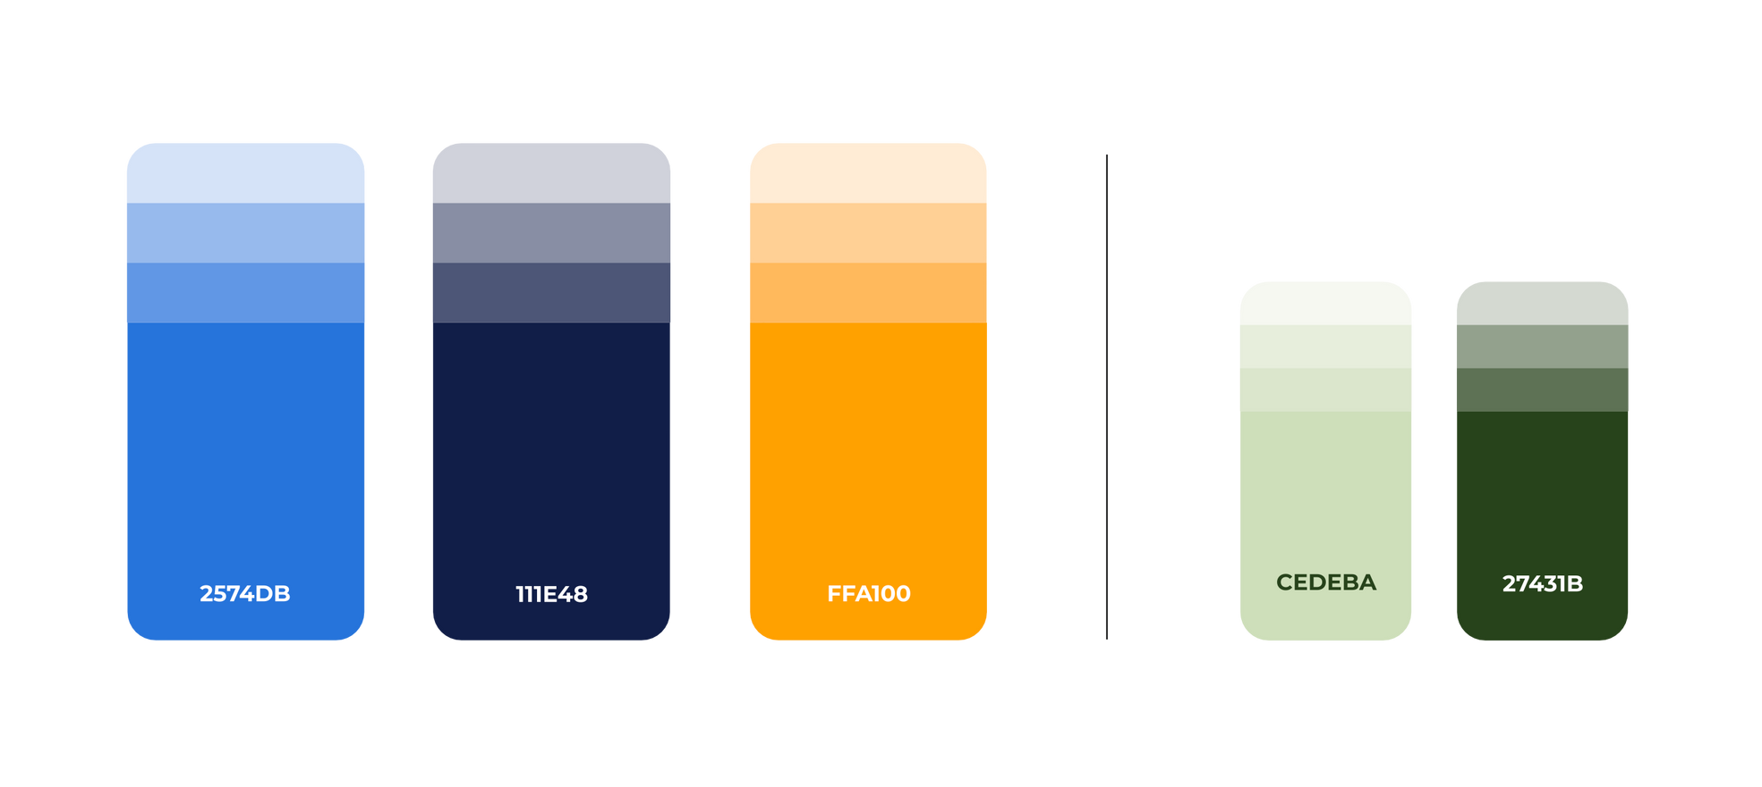
PRIMARY COLORS
SECONDARY COLORS

Slide 3

TYPOGRAPHY
Poppins Bold
Aa
Poppins
A B C D E F G H I J K L M N O P Q R S T U V W X Y Z
a b c d e f g h i j k l m n o p q r s t u v w x y z
1 2 3 4 5 6 7 8 9 10
Poppins Regular
A B C D E F G H I J K L M N O P Q R S T U V W X Y Z
a b c d e f g h i j k l m n o p q r s t u v w x y z
1 2 3 4 5 6 7 8 9 10

Slide 4




Slide 5




Slide 6
Title goes here

Slide 7
Title goes here

Slide 8
Presentation
Template
Mobile Commons LLC
hello@mobilecommons.com
DATE

Slide 9


Mobile Commons LLC
hello@mobilecommons.com
DATE

Slide 10

Mobile Commons LLC
hello@mobilecommons.com
DATE

